Slide 1
Program Name goes here
Link to github Repository: Github
Links to trello board / project management tools: Trello Board
You MUST provide evidence showing how the problem has been decomposed, how the components have been developed and trialled, and of how they have been assembled and tested to create a final, working outcome.

Slide 2
Relevant Implications
Explain the relevant implications here. Please watch this video to learn how to do this.
Notes:
Explain the relevant implications here. Then as you work, develop your code, discuss how the implications are being met.

Slide 3
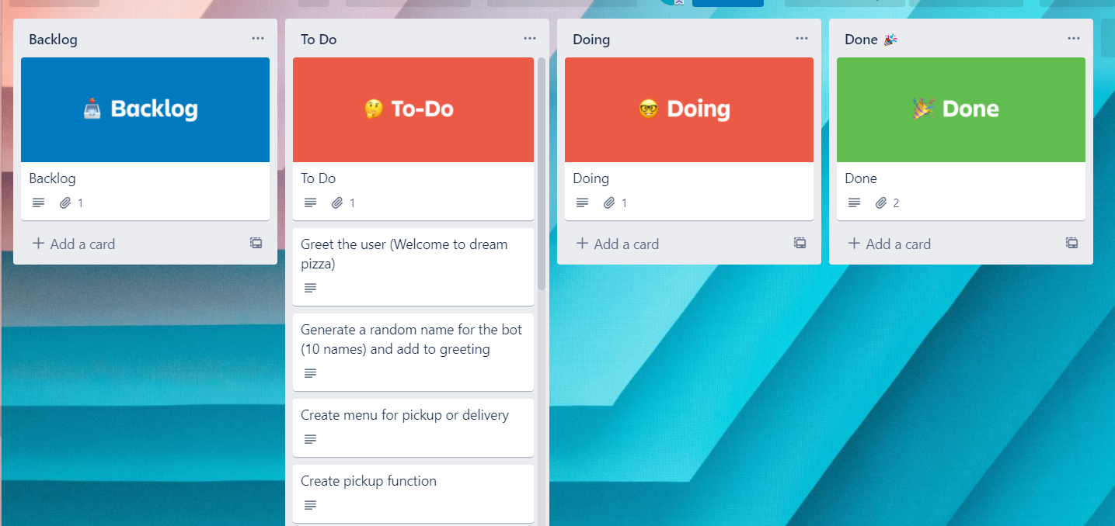
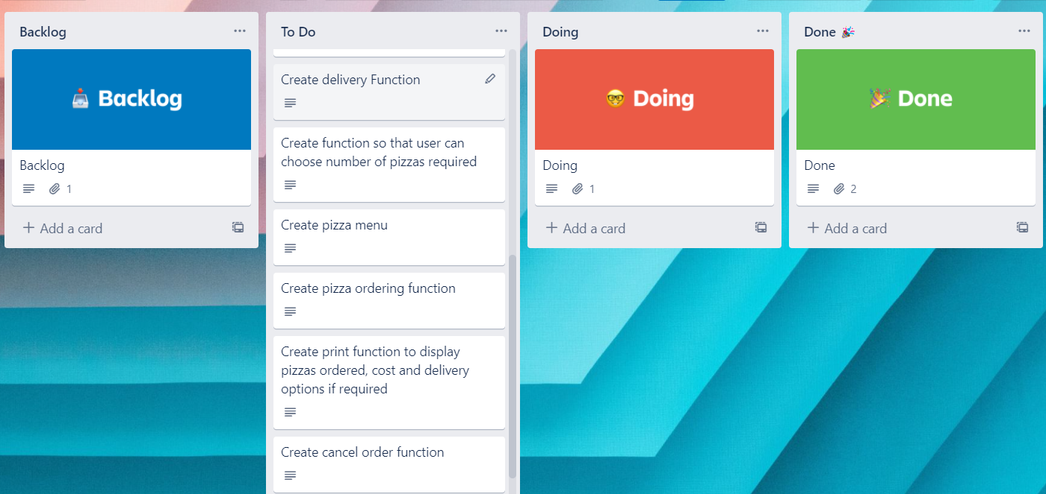
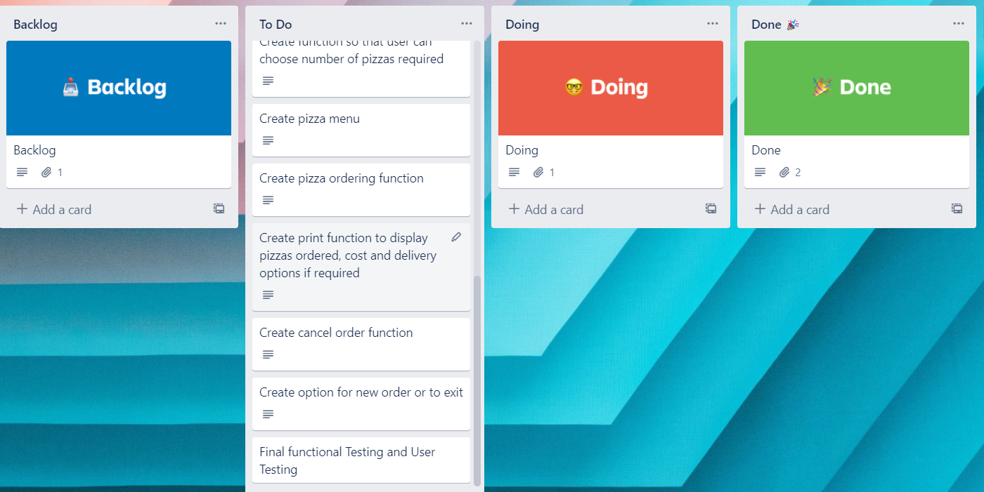
Decomposition
Notes:
Paste screenshots of your initial Trello board / task decomposition on this slide. If you have a long list, you might need to break it up into several columns. Delete this instruction when you are done.

Slide 4
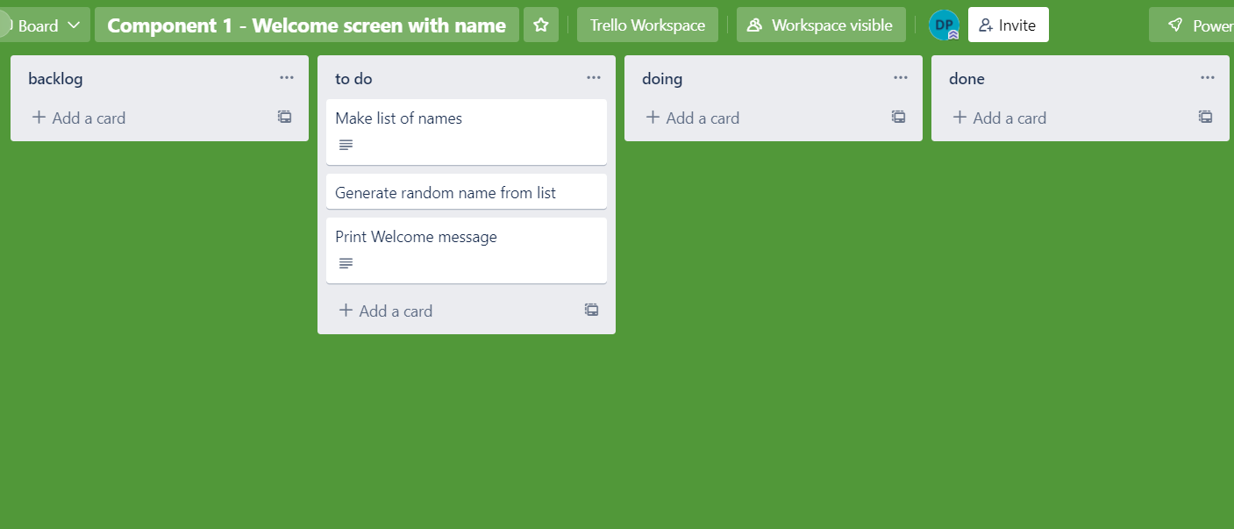
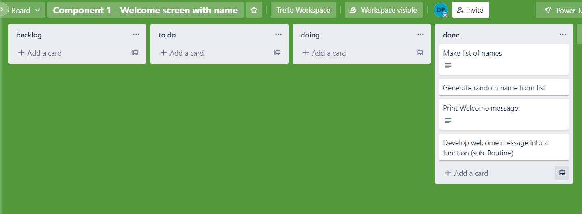
Component 1 – Welcome message (Trello screenshot) Version 1 Version 2

Slide 5
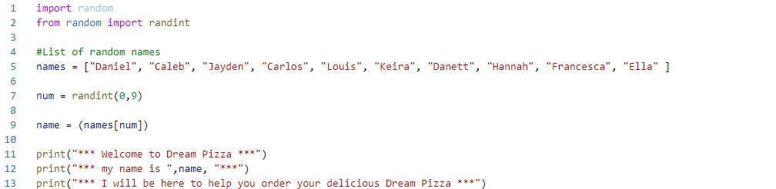
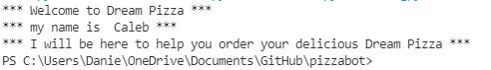
Component 1 - Test Plan (and screenshot)
Test Case | Expected Values
Run Program | Print Welcome message with random names from list of names – Runs correctly

Slide 6
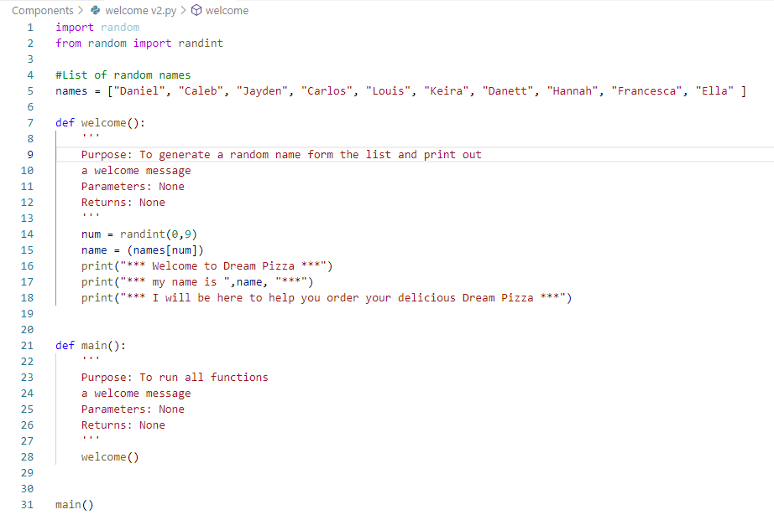
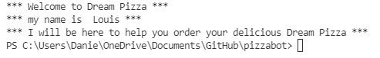
Component 1 version 2 - Test Plan (and screenshot)
Test Case | Expected Values
Run Program | Main and welcome run correctly. Welcome message prints with random name

Slide 7
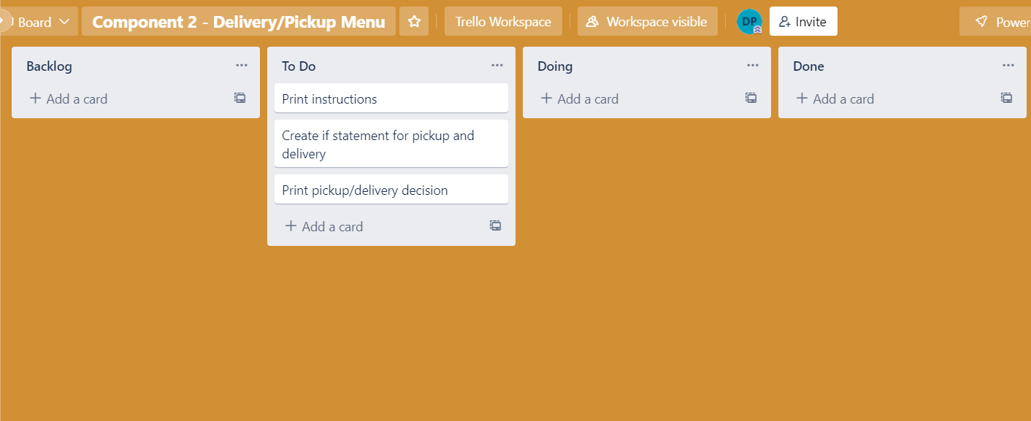
Component 2 – Pickup/delivery choice (Trello screenshot)

Slide 8
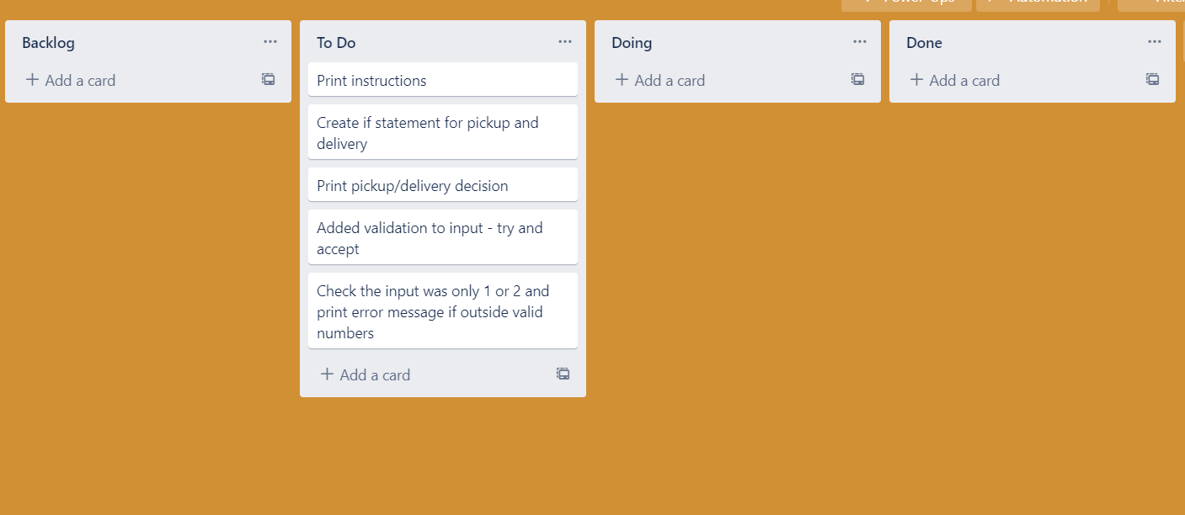
Component 2 Version 2 – Pickup/delivery choice (Trello screenshot)

Slide 9
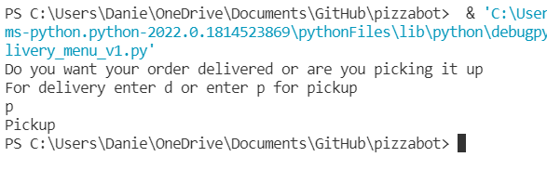
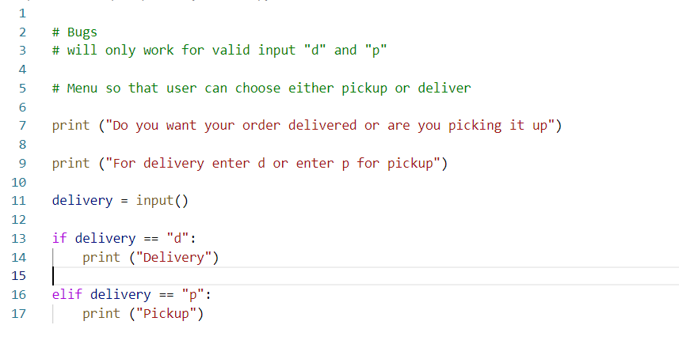
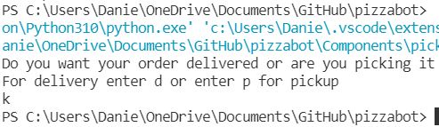
Component 2 version 1 - Test Plan (and screenshot)
Test Case | Expected Values
Run Program | Enter p, program prints pickup Enter d, program prints delivery Enter invalid program stops

Slide 10
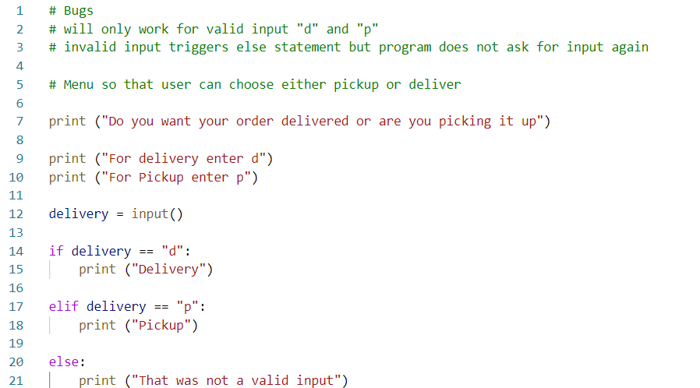
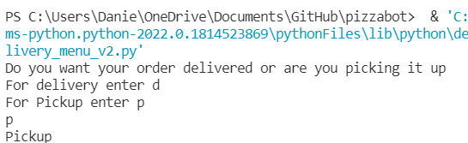
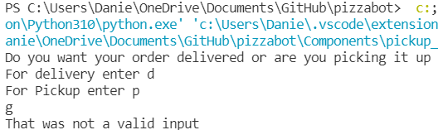
Component 2 version 2 - Test Plan (and screenshot)
Test Case | Expected Values
Run Program | Enter p, program prints pickup Enter d, program prints delivery Enter invalid, program prints error message

Slide 11
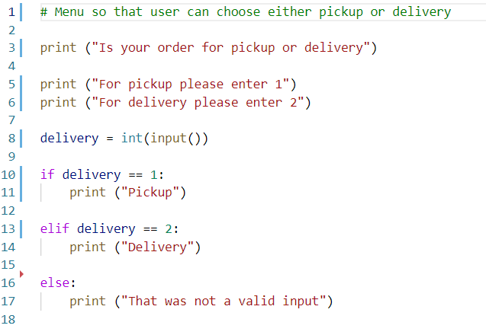
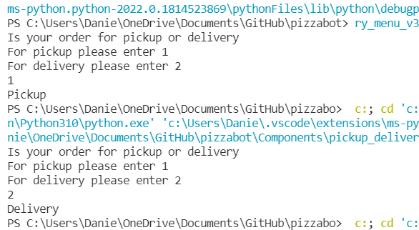
Component 2 version 3 - Test Plan (and screenshot)
Test Case | Expected Values
Run Program | Enter 1, program prints pickup Enter 2, program prints delivery Enter invalid, program displays value error

Slide 12
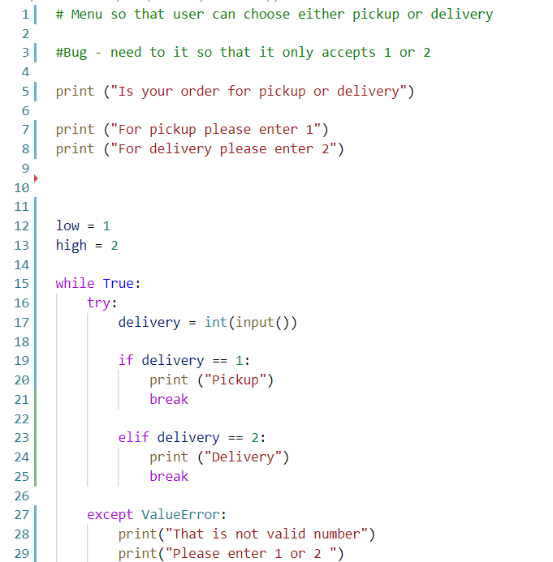
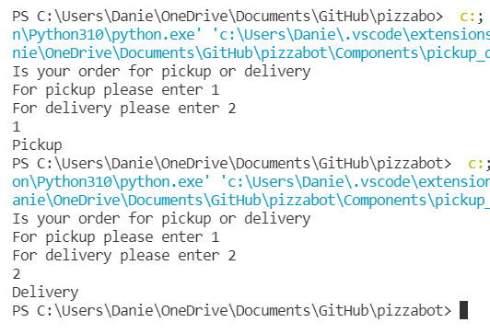
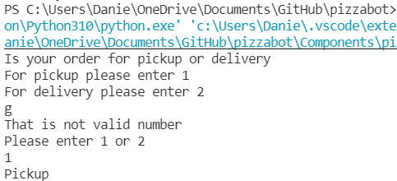
Component 2 version 4 - Test Plan (and screenshot)
Test Case | Expected Values
Run Program | Enter 1, program prints pickup Enter 2, program prints delivery Enter invalid, program displays value error Enter number other than 1 or 2 the program does not work

Slide 13
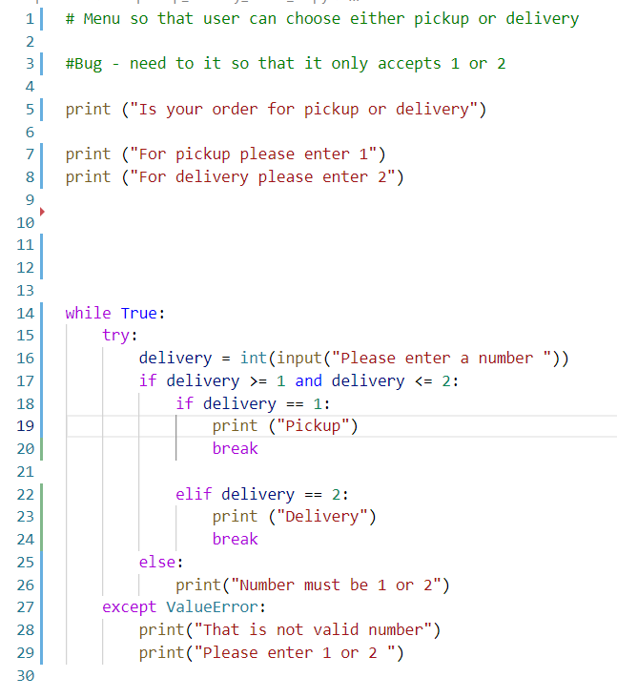
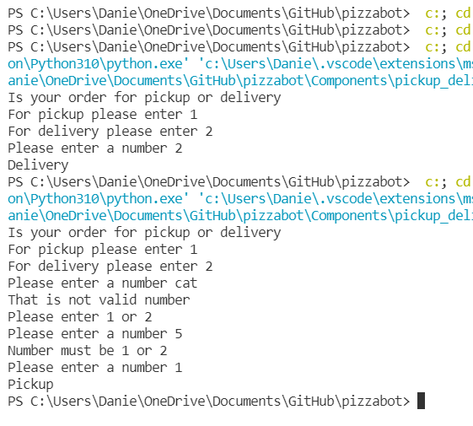
Component 2 version 5 - Test Plan (and screenshot)
Test Case | Expected Values
Run Program | Enter 1, program prints pickup Enter 2, program prints delivery Enter invalid entry, program asks for input again Enter number other than 1 or 2 – error message asks for entry again

Slide 14
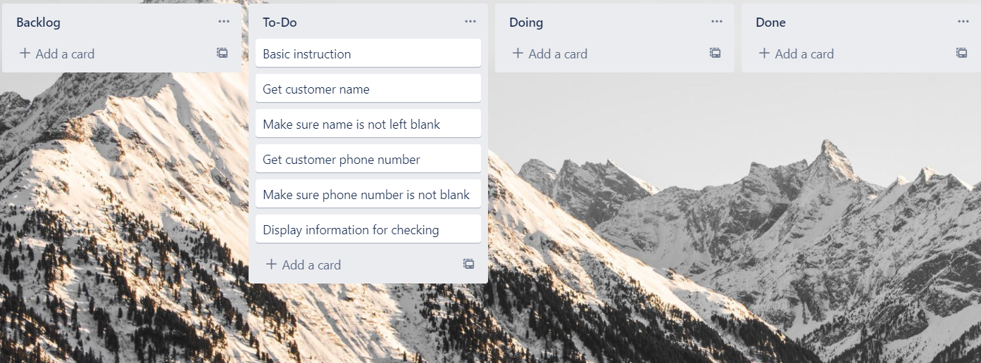
Component 3 Pick up info v1 (Trello screenshot)

Slide 15
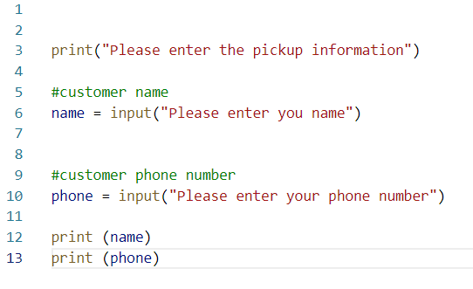
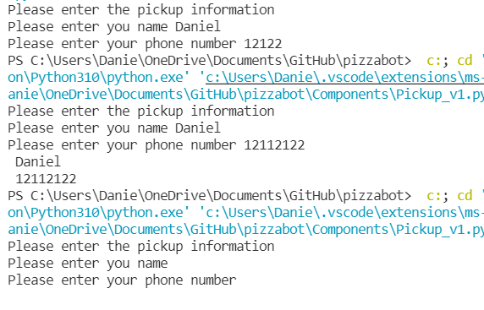
Component 3 version 1 - Test Plan (and screenshot)
Test Case | Expected Values
Input name Input phone number Left input blank | Printed name correctly Printed phone number Accepted blank and printed blank input

Slide 16
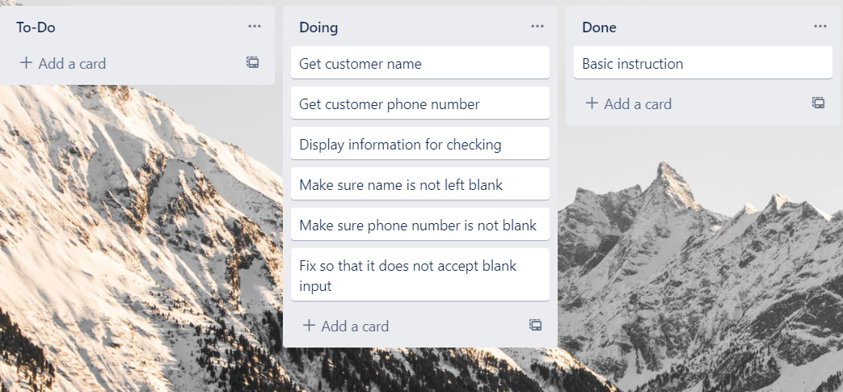
Component 3 Pick up info v2 (Trello screenshot)

Slide 17
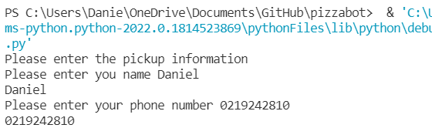
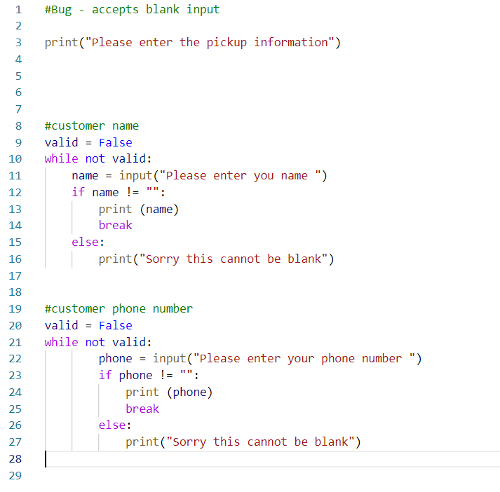
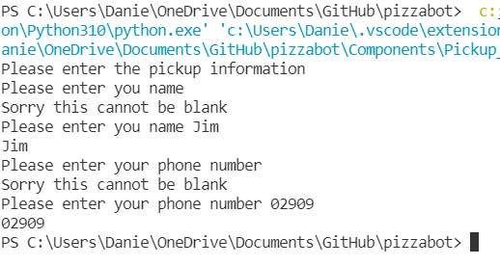
Component 3 version 2 - Test Plan (and screenshot)
Test Case | Expected Values
Input name Input phone number Left input blank | Printed name correctly Printed phone number Prints “Sorry this cannot be blank – goes back to input

Slide 18
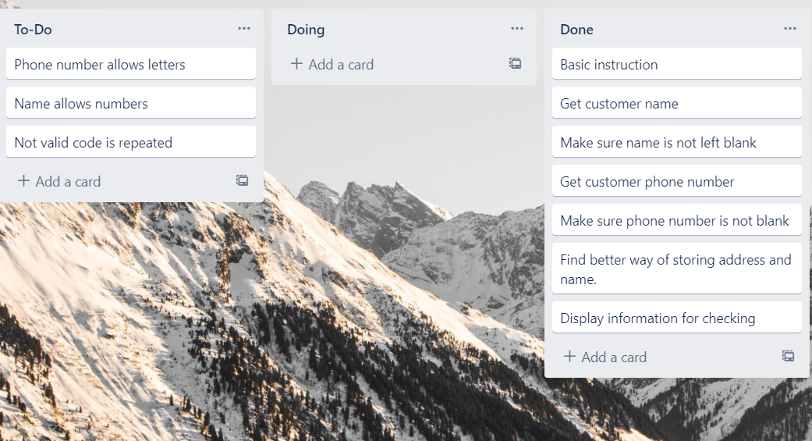
Component 3 Pick up info v3 (Trello screenshot)

Slide 19
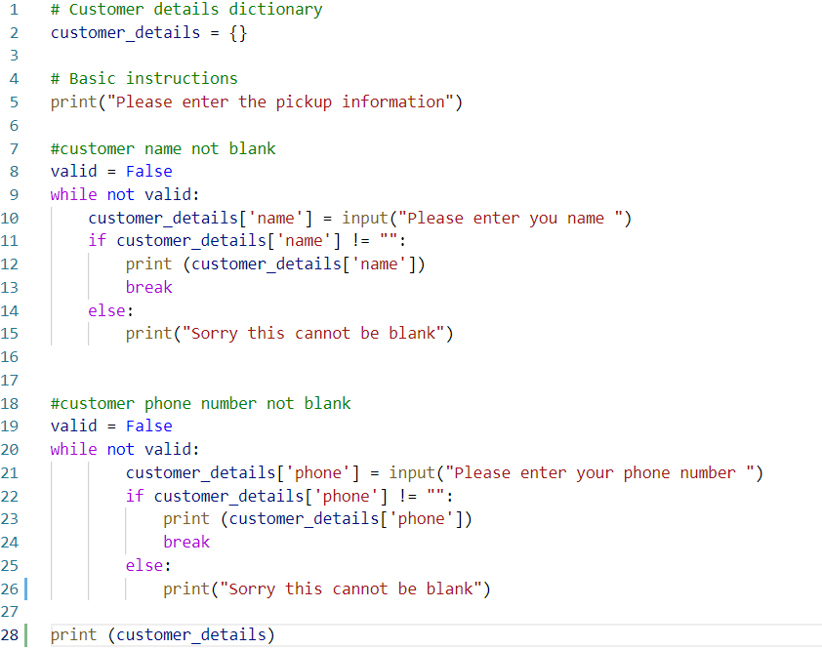
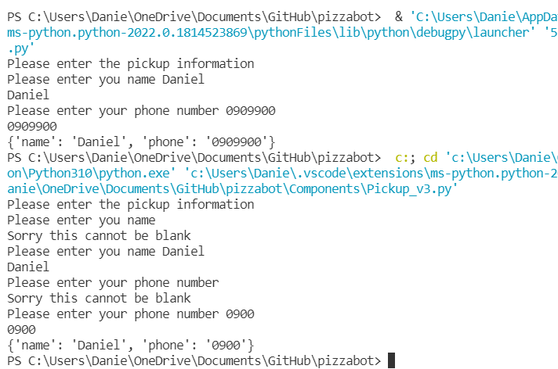
Component 3 version 3 - Test Plan (and screenshot)
Test Case | Expected Values
Input name Input phone number Left input blank | Printed name correctly Printed phone number Prints “Sorry this cannot be blank – goes back to input

Slide 20
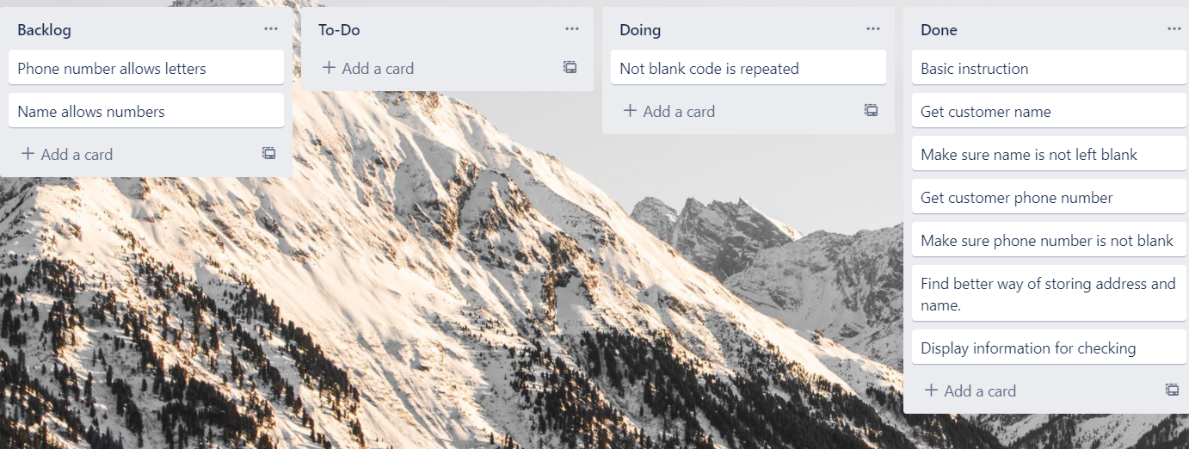
Component 3 Pick up info v4 (Trello screenshot)

Slide 21
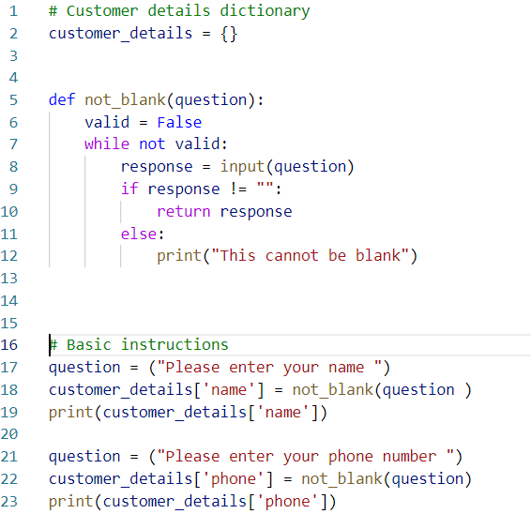
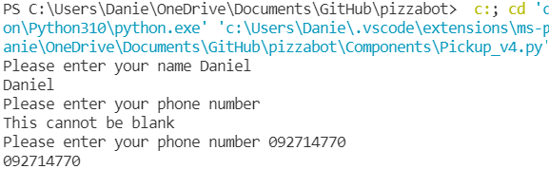
Component 3 version 4 - Test Plan (and screenshot)
Test Case | Expected Values
Input name Input phone number Left input blank | Printed name correctly Printed phone number Prints “Sorry this cannot be blank – goes back to input

Slide 22
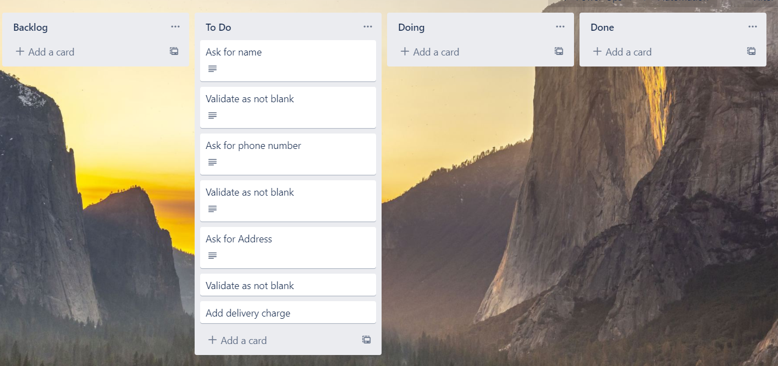
Component 4 Delivery info v1 (Trello screenshot)

Slide 23
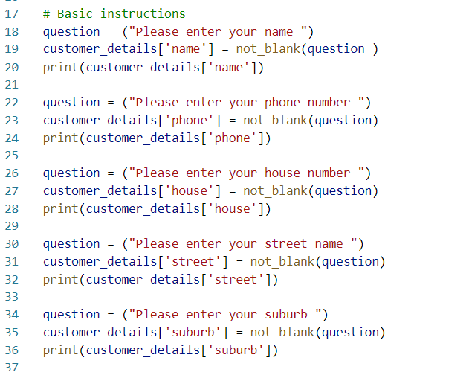
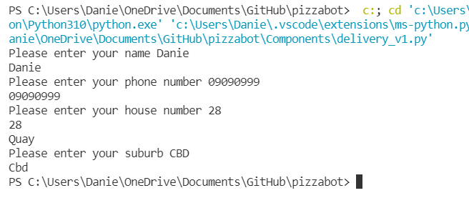
Component 4 version 1 - Test Plan (and screenshot)
Test Case | Expected Values
Input name Input phone number Input house number Input street name Input suburb Left input blank | Printed name correctly Printed phone number Prints house number Printed street name Printed suburb name Prints “Sorry this cannot be blank” – goes back to input

Slide 24
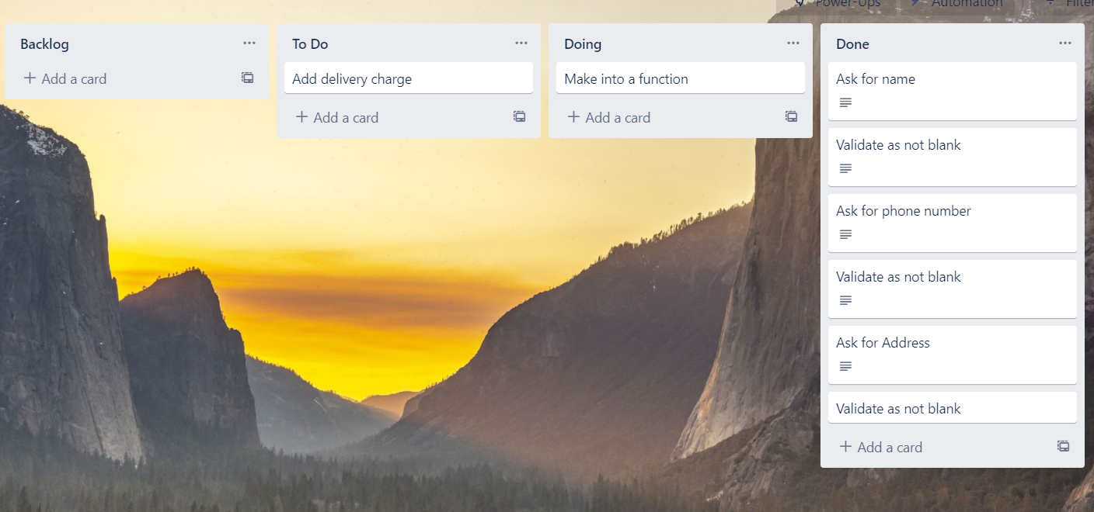
Component 4 Delivery info v2 (Trello screenshot)

Slide 25
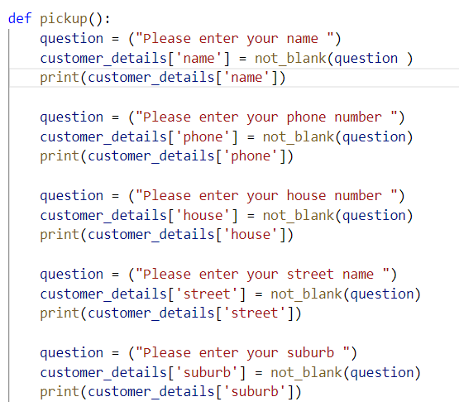
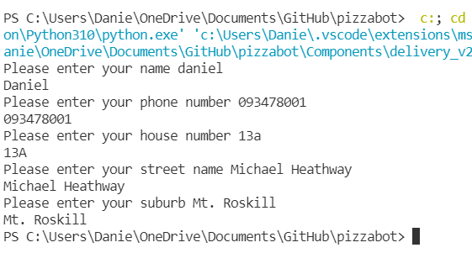
Component 4 version 2 - Test Plan (and screenshot)
Test Case | Expected Values
Input name Input phone number Input house number Input street name Input suburb Left input blank | Printed name correctly Printed phone number Prints house number Printed street name Printed suburb name Prints “Sorry this cannot be blank” – goes back to input

Slide 26
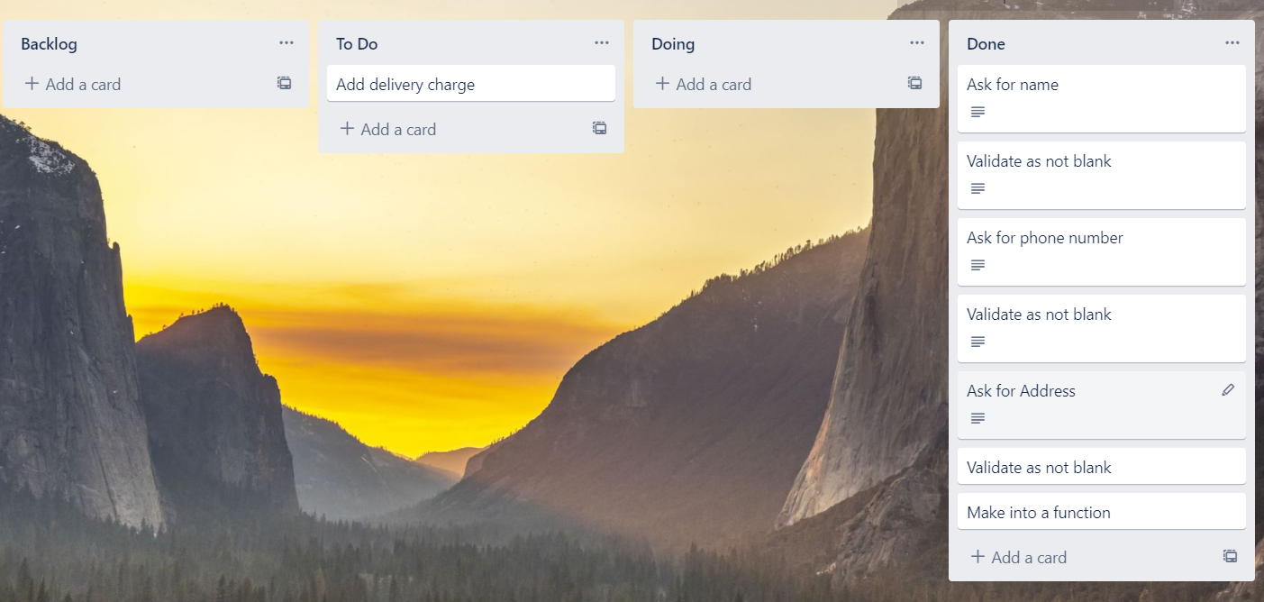
Component 4 Delivery info v3 (Trello screenshot)

Slide 27
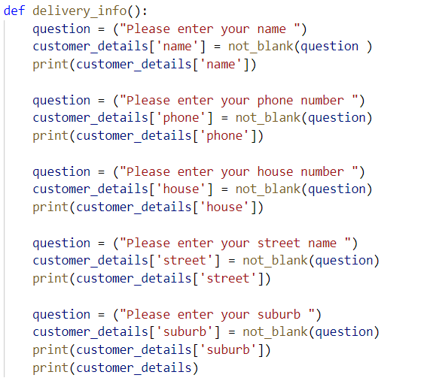
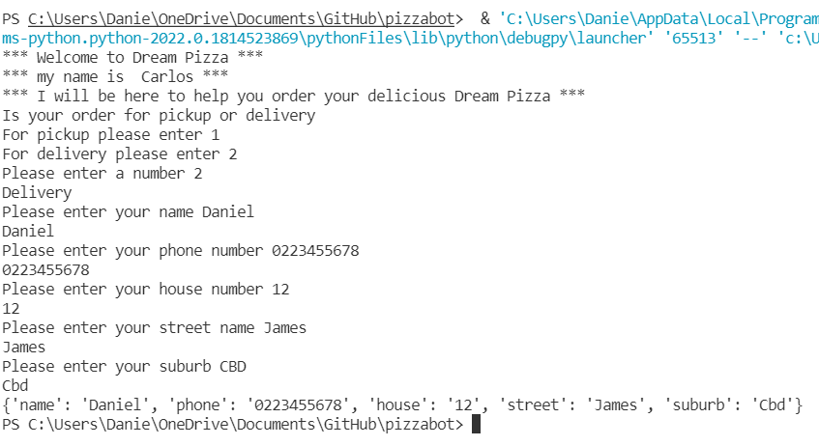
Component 4 version 3 - Test Plan (and screenshot)
Test Case | Expected Values
Input name Input phone number Input house number Input street name Input suburb Left input blank | Printed name correctly Printed phone number Prints house number Printed street name Printed suburb name Prints “Sorry this cannot be blank” – goes back to input

Slide 28
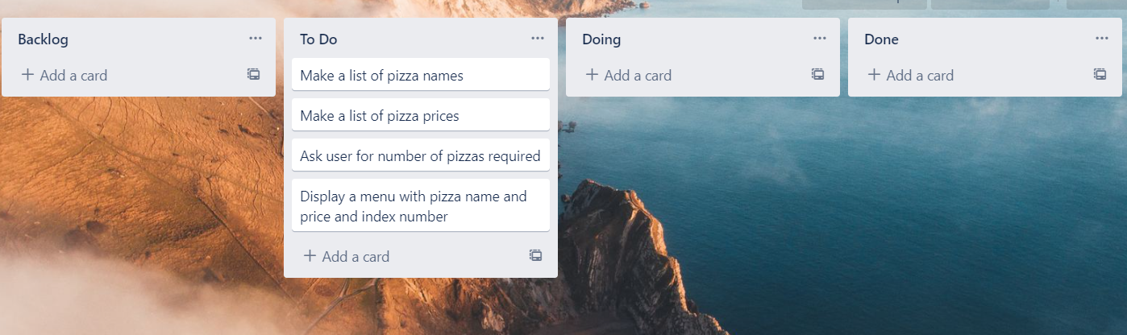
Component 5 Pizza Menu v1 (Trello screenshot)

Slide 29
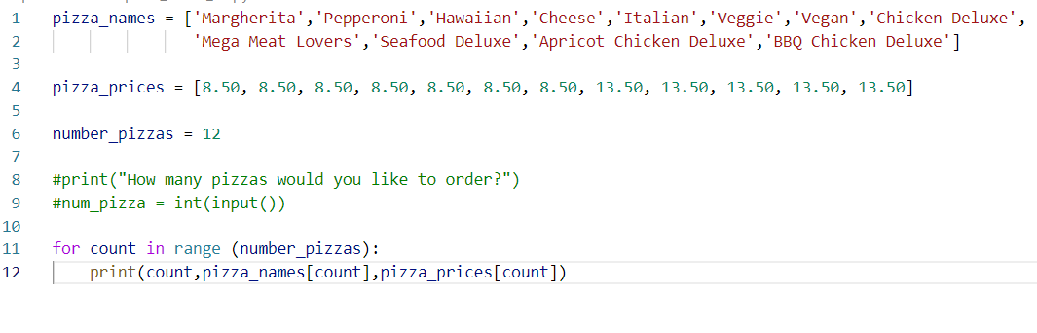
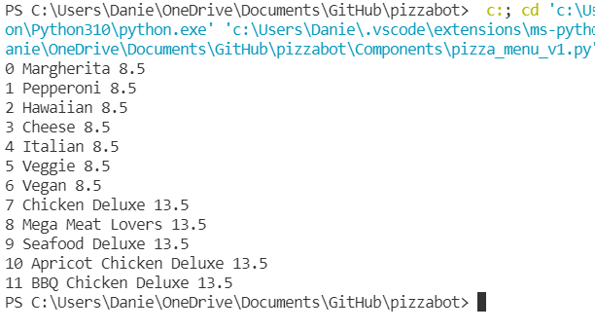
Component 5 version 1 - Test Plan (and screenshot)
Test Case | Expected Values
Run file | Printed a list with index number, pizzas and prices

Slide 30
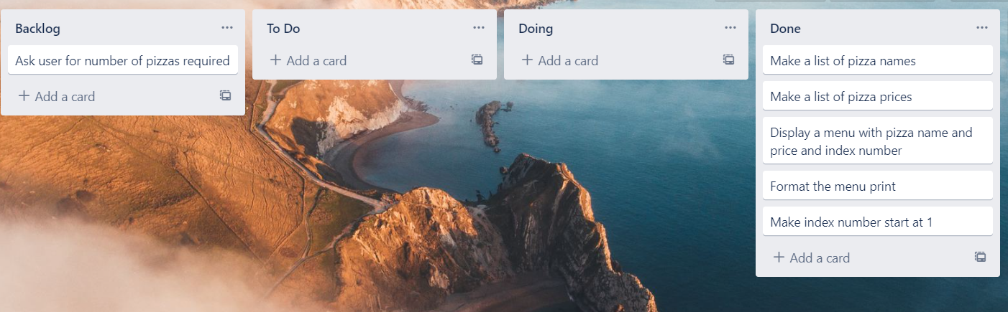
Component 5 Pizza Menu v2 (Trello screenshot)

Slide 31


Component 5 version 2 - Test Plan (and screenshot)
Test Case | Expected Values
Run file | Printed a list with index number, pizzas and prices with price formatted to 2 decimal places and dollar sign. Menu starts at 1

Slide 32

Component 5 Pizza Menu v3 (Trello screenshot)

Slide 33


Component 5 Intergrated into main program- Test Plan (and screenshot)
Test Case | Expected Values
Run file | Printed a list with index number, pizzas and prices with price formatted to 2 decimal places and dollar sign. Menu starts at 1

Slide 34

Component 6 Pizza Menu v1 (Trello screenshot)

Slide 35


Component 6 version 1 - Test Plan (and screenshot)
Test Case | Expected Values
Entered 5 pizzas Entered cat | Stepped through the menu choice 5 times Program broke

Slide 36
Component 6 Pizza Menu v2 (Trello screenshot)

Slide 37
Component 6 version 2 - Test Plan (and screenshot)
Test Case | Expected Values

Slide 38
Version Control Evidence
Your version control evidence should go here. This could be in the form of annotated screenshots which show you you managed this process or you could make a brief screencast explaining how you implemented version control.
Notes:
Your version control evidence should go here. This could be in the form of annotated screenshots which show you you managed this process or you could make a brief screencast explaining how you implemented version control.

Slide 39
Discusses how the information from planning, testing and trialling of components assisted in the development of a high-quality outcome
Notes:
Discusses how the information from planning, testing and trialling of components assisted in the development of a high-quality outcome

